Slide 1
Input-Output Organization
UNIT-3 2nd Part

Slide 2
Peripheral Devices
I/O Subsystem
The Input / output organization of computer depends upon the size of computer and the peripherals connected to it.
The I/O Subsystem of the computer, provides an efficient mode of communication between the central system and the outside environment.
Peripheral (or I/O Device)
Device that are under the control of the direct control of computer are said to be connected- online.
Input or output devices attached to a computer are called as peripherals.
There are three types of peripherals:
Input
Output
input- Output

Slide 3
Peripheral Devices
Input or Output devices attached to the computer
i) Monitor- CRT, LCD
ii) Keyboard
iii) Mouse- : light pen, mouse, touch screen, joy stick, digitizer
iv) Printer- Dot matrix (impact), thermal, ink jet, laser (non-impact)
v) Storage Device : Magnetic tape, magnetic disk, optical disk

Slide 4
Input - Output Interface
Input Output Interface provides a method for transferring information between internal storage and external I/O devices.
Peripherals connected to a computer need special communication links for interfacing them with the central processing unit.
The purpose of communication link is to resolve the differences that exist between the central computer and each peripheral.

Slide 5
The Major Differences are:-
Peripherals are electromechnical and electromagnetic devices and their manner of operation of the CPU and memory, which are electronic devices. Therefore, a conversion of signal values may be needed.
The data transfer rate of peripherals is usually slower than the transfer rate of CPU and consequently, a synchronization mechanism may be needed.
Data codes and formats in the peripherals differ from the word format in the CPU and memory.
The operating modes of peripherals are different from each other and must be controlled so as not to disturb the operation of other peripherals connected to the CPU.

Slide 6
Input - Output Interface
To Resolve these differences, computer systems include special hardware components between the CPU and Peripherals to supervises and synchronizes all input and out transfers. These components are called Interface Units because they interface between the processor bus and the peripheral devices.

Slide 7
I/O BUS and Interface Module
It defines the typical link between the processor and several peripherals.
The I/O Bus consists of data lines, address lines and control lines.
The I/O bus from the processor is attached to all peripherals interface.
To communicate with a particular device, the processor places a device address on address lines.
Each Interface decodes the address and control received from the I/O bus, interprets them for peripherals and provides signals for the peripheral controller.
It is also synchronizes the data flow and supervises the transfer between peripheral and processor
Each peripheral has its own controller. For example, the printer controller controls the paper motion, the print timing.

Slide 8
I/O BUS and Interface Module
The control lines are referred as an I/O command. The commands are as following:
Control command- A control command is issued to activate the peripheral and to inform it what to do.
Status command- A status command is used to test various status conditions in the interface and the peripheral.
Output data command- A data output command causes the interface to respond by transferring data from the bus into one of its registers.
Input data command- The data input command is the opposite of the data output. In this case the interface receives on item of data from the peripheral and places it in its buffer register.

Slide 9
I/O BUS and Interface Module
Data
Processor
Address
Control
Interface
Interface
Interface
Keyboard and display terminal
Printer
Magnetic disk
Connection of I/O bus to input-output devices

Slide 10
I/O Versus Memory Bus
To communicate with I/O, the processor must communicate with the memory unit. Like the I/O bus, the memory bus contains data, address and read/write control lines. There are 3 ways that computer buses can be used to communicate with memory and I/O:
i. Use two Separate buses , one for memory and other for I/O.
ii. Use one common bus for both memory and I/O but separate control lines for each.
iii. Use one common bus for memory and I/O with common control lines.

Slide 11
I/O Processor
In the first method, the computer has independent sets of data, address and control buses one for accessing memory and other for I/O. This is done in computers that provides a separate I/O processor (IOP). The purpose of IOP is to provide an independent pathway for the transfer of information between external device and internal memory.

Slide 12
Asynchronous Data Transfer
This Scheme is used when speed of I/O devices do not match with microprocessor, and timing characteristics of I/O devices is not predictable. In this method, process initiates the device and check its status. As a result, CPU has to wait till I/O device is ready to transfer data. When device is ready CPU issues instruction for I/O transfer. In this method two types of techniques are used based on signals before data transfer.
i. Strobe Control
ii. Handshaking

Slide 13
Strobe Signal
The strobe control method of Asynchronous data transfer employs a single control line to time each transfer. The strobe may be activated by either the source or the destination unit.

Slide 14
Data Transfer Initiated by Source Unit
Data Bus
Source
Unit
Destination Unit
Strobe
(a) Block Diagram
Data
Valid data
Strobe
(b) Timing Diagram
Source-Initiated strobe for Data Transfer

Slide 15
Data Transfer Initiated by Destination Unit
Data Bus
Source
Unit
Destination Unit
Strobe
(a) Block Diagram
Data
Valid data
Strobe
(b) Timing Diagram
Destination-Initiated strobe for Data Transfer

Slide 16
Data Transfer Initiated by Destination Unit
In this method, the destination unit activates the strobe pulse, to informing the source to provide the data. The source will respond by placing the requested binary information on the data bus.
The data must be valid and remain in the bus long enough for the destination unit to accept it. When accepted the destination unit then disables the strobe and the source unit removes the data from the bus.

Slide 17
Disadvantage of Strobe Signal
The disadvantage of the strobe method is that, the source unit initiates the transfer has no way of knowing whether the destination unit has actually received the data item that was places in the bus. Similarly, a destination unit that initiates the transfer has no way of knowing whether the source unit has actually placed the data on bus. The Handshaking method solves this problem.

Slide 18
Handshaking
The handshaking method solves the problem of strobe method by introducing a second control signal that provides a reply to the unit that initiates the transfer.

Slide 19
Principle of Handshaking
The basic principle of the two-wire handshaking method of data transfer is as follow:
One control line is in the same direction as the data flows in the bus from the source to destination. It is used by source unit to inform the destination unit whether there a valid data in the bus. The other control line is in the other direction from the destination to the source. It is used by the destination unit to inform the source whether it can accept the data. The sequence of control during the transfer depends on the unit that initiates the transfer.

Slide 20
Source Initiated Transfer using Handshaking
The sequence of events shows four possible states that the system can be at any given time. The source unit initiates the transfer by placing the data on the bus and enabling its data valid signal. The data accepted signal is activated by the destination unit after it accepts the data from the bus. The source unit then disables its data accepted signal and the system goes into its initial state.

Slide 21
Handshaking
Data Bus
Source Unit
Data Valid
Destination Unit
Data accepted
(a) Block Diagram
Source unit
Destination Unit
Place the data on bus.
Enable data Valid.
Accept data from bus.
Enable data accepted.
Disable data valid.
Invalidate data on bus.
Disable data accepted. Ready to accept data.
Sequence of events

Slide 22
Destination Initiated Transfer Using Handshaking
The name of the signal generated by the destination unit has been changed to ready for data to reflects its new meaning. The source unit in this case does not place data on the bus until after it receives the ready for data signal from the destination unit. From there on, the handshaking procedure follows the same pattern as in the source initiated case.
The only difference between the Source Initiated and the Destination Initiated transfer is in their choice of Initial sate.

Slide 23
Data Bus
Source Unit
Data Valid
Destination Unit
Ready for data
(a) Block Diagram
Destination Unit
Source unit
Ready to accept data. Enable ready for data.
Place the data on bus.
Enable data Valid.
Disable data valid.
Invalidate data on bus.
Accept data from bus. Disable ready for data.
Sequence of events
Destination-Initiated transfer using Handshaking

Slide 24
Asynchronous Serial Transmission
The transfer of data between two units is serial or parallel. In parallel data transmission, n bit in the message must be transmitted through n separate conductor path. In serial transmission, each bit in the message is sent in sequence one at a time.
Parallel transmission is faster but it requires many wires. It is used for short distances and where speed is important. Serial transmission is slower but is less expensive.

Slide 25
Asynchronous Serial Transmission
In Asynchronous serial transfer, each bit of message is sent a sequence at a time, and binary information is transferred only when it is available. When there is no information to be transferred, line remains idle.
In this technique each character consists of three points :
i. Start bit
ii. Character bit
iii. Stop bit

Slide 26
Asynchronous Serial Transmission
Start Bit- First bit, called start bit is always zero and used to indicate the beginning character.
Stop Bit- Last bit, called stop bit is always one and used to indicate end of characters. Stop bit is always in the 1- state and frame the end of the characters to signify the idle or wait state.
Character Bit- Bits in between the start bit and the stop bit are known as character bits. The character bits always follow the start bit.

Slide 27
Asynchronous Serial Transmission
0
1 1
0 0 0
1
0
1
Start bit
Stop bits
Character bits
Asynchronous Serial Transmission

Slide 28
Asynchronous Serial Transmission
Serial Transmission of Asynchronous is done by two ways:
a) Asynchronous Communication Interface
b) First In First out Buffer

Slide 29
Asynchronous Communication Interface
It works as both a receiver and a transmitter. Its operation is initialized by CPU by sending a byte to the control register.
The transmitter register accepts a data byte from CPU through the data bus and transferred to a shift register for serial transmission.
The receive portion receives information into another shift register, and when a complete data byte is received it is transferred to receiver register.
CPU can select the receiver register to read the byte through the data bus. Data in the status register is used for input and output flags.

Slide 30
First In First Out Buffer (FIFO)
A First In First Out (FIFO) Buffer is a memory unit that stores information in such a manner that the first item is in the item first out. A FIFO buffer comes with separate input and output terminals. The important feature of this buffer is that it can input data and output data at two different rates.

Slide 31
First In First Out Buffer (FIFO)
When placed between two units, the FIFO can accept data from the source unit at one rate, rate of transfer and deliver the data to the destination unit at another rate.
If the source is faster than the destination, the FIFO is useful for source data arrive in bursts that fills out the buffer. FIFO is useful in some applications when data are transferred asynchronously.

Slide 32
Modes of Data Transfer
Transfer of data is required between CPU and peripherals or memory or sometimes between any two devices or units of your computer system. To transfer a data from one unit to another one should be sure that both units have proper connection and at the time of data transfer the receiving unit is not busy. This data transfer with the computer is Internal Operation.

Slide 33
Modes of Data Transfer
All the internal operations in a digital system are synchronized by means of clock pulses supplied by a common clock pulse Generator. The data transfer can be
i. Synchronous or
ii. Asynchronous

Slide 34
Modes of Data Transfer
When both the transmitting and receiving units use same clock pulse then such a data transfer is called Synchronous process. On the other hand, if the there is not concept of clock pulses and the sender operates at different moment than the receiver then such a data transfer is called Asynchronous data transfer.

Slide 35
Modes of Data Transfer
The data transfer can be handled by various modes. some of the modes use CPU as an intermediate path, others transfer the data directly to and from the memory unit and this can be handled by 3 following ways:
i. Programmed I/O
ii. Interrupt-Initiated I/O
iii. Direct Memory Access (DMA)

Slide 36
Programmed I/O Mode
In this mode of data transfer the operations are the results in I/O instructions which is a part of computer program. Each data transfer is initiated by a instruction in the program. Normally the transfer is from a CPU register to peripheral device or vice-versa.

Slide 37
Programmed I/O Mode
Once the data is initiated the CPU starts monitoring the interface to see when next transfer can made. The instructions of the program keep close tabs on everything that takes place in the interface unit and the I/O devices.
In this technique CPU is responsible for executing data from the memory for output and storing data in memory for executing of Programmed I/O as shown in Flowchart-:

Slide 38
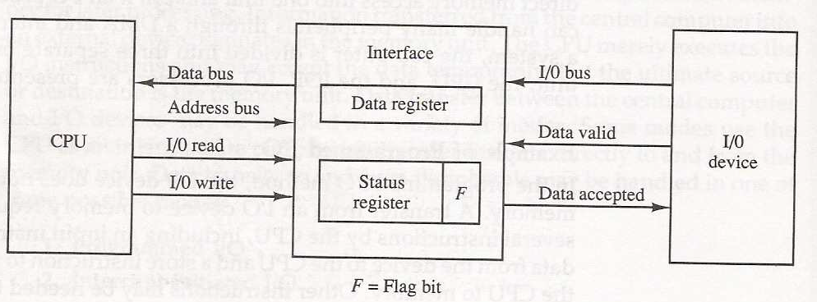
Data transfer from I/O device to CPU

Slide 39
Programmed I/O
CPU issues the read or write command to I/O module
I/O module informs about its status to CPU
Status
Error
Busy
Ready
CPU reads word from I/O module & writes it to memory or CPU reads word from memory & writes it to I/O module
Is transfer
complete
NO
yes
Execute next instruction

Slide 40
Drawback of the Programmed I/O
The main drawback of the Program Initiated I/O was that the CPU has to monitor the units all the times when the program is executing. Thus the CPU stays in a program loop until the I/O unit indicates that it is ready for data transfer. This is a time consuming process and the CPU time is wasted a lot in keeping an eye to the executing of program.
To remove this problem an Interrupt facility and special commands are used.

Slide 41
Interrupt-Initiated I/O
In this method an interrupt facility an interrupt command is used to inform the device about the start and end of transfer. In the meantime the CPU executes other program. When the interface determines that the device is ready for data transfer it generates an Interrupt Request and sends it to the computer.

Slide 42
Interrupt-Initiated I/O
When the CPU receives such an signal, it temporarily stops the execution of the program and branches to a service program to process the I/O transfer and after completing it returns back to task, what it was originally performing.
The Execution process of Interrupt–Initiated I/O is represented in the flowchart:

Slide 43
Interrupt –Initiated I/O
CPU issues the read or write command to I/O module
I/O module informs about its status to CPU
Status
Error
Ready
CPU reads word from I/O module & writes it to memory or CPU reads word from memory & writes it to I/O module
Is transfer
complete
NO
yes
Execute next instruction

Slide 44
Priority Interrupt
The data transfer between the CPU and an I/O device is by the CPU.
The CPU can not start transfer unless the device is ready to communicate with the CPU.
The readiness of the device can be determined from an interrupt signal.
The CPU responds to the interrupt request by storing the return address from PC into memory stack and then the program branches to a service routine that process the required transfer.

Slide 45
Priority Interrupt
Priority Interrupt is a system that establishes a priority over the various sources to determine which condition is to be serviced first when two or more requests arrive simultaneously.
The system may also determine which conditions are permitted to interrupt the computer while another interrupt is being serviced.
Higher priority interrupt levels are assigned, which if delayed or interrupted, could have consequences.
Device with high speed transfer such as magnetic disc are given high priority, and slow devices such as keyboard receives low priority.

Slide 46
Priority Interrupt
Priority Interrupts can be identified by two means: software and hardware.
1. Software:
A polling procedure is used to identify the interrupt source having the highest priority source by software means.
Only one branch address is used for all interrupts.
The priority of each interrupt source determines the order in which it is polled.
The source with the highest priority is tested first, and if its interrupt signal is on, control branches to a routine that services that source. Otherwise, the source with the next lower priority is tested, and so on.
2. Hardware
A hardware priority interrupt unit functions as an overall manager in an interrupt system environment.
The unit accepts interrupt requests from many sources, determines which request has the highest priority, and issues an interrupt request to the computer based on this determination.

Slide 47
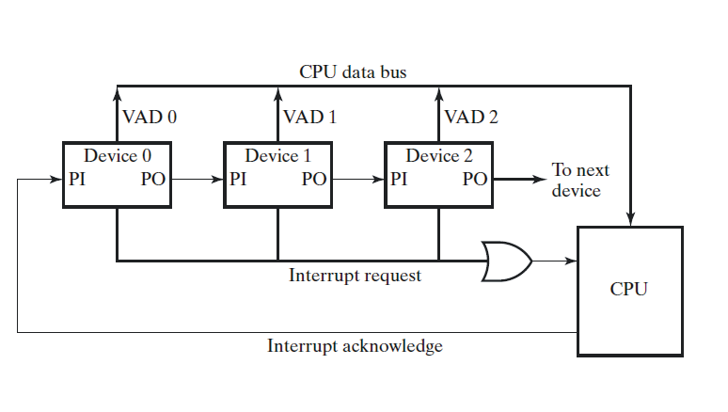
Daisy-chain Priority

Slide 48
Daisy-chain Priority
All devices that can request an interrupt are connected serially and in priority order with the highest priority device placed first on the daisy chain, farthest from the CPU, and the lowest priority device placed last and closest to the CPU.
First, any (or all) of the devices signal an interrupt on the Interrupt Request line.
Next, the CPU acknowledges the interrupt on the Interrupt Acknowledge line.
A device on the line passes the Interrupt Acknowledge signal to the next lower priority device only if it has NOT requested service.
The first device on the priority chain requiring service asserts it interrupt vector address (VAD) on the CPU data bus.
The CPU services the device
The Interrupt Acknowledge signal is passed to the next lower priority device and steps 2 – 6 are performed for the next lower priority device.

Slide 49
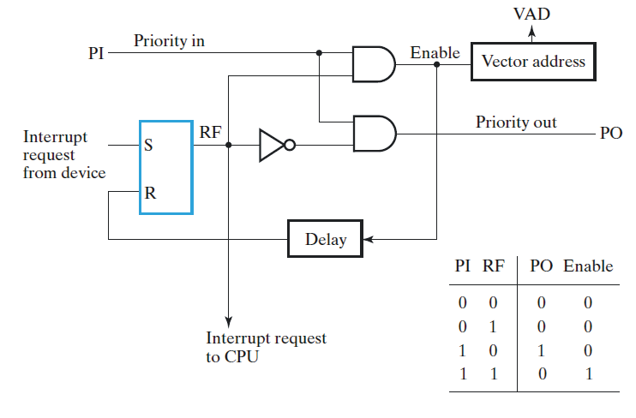
One Stage of the Daisy Chain Priority Arrangement

Slide 50
One Stage of the Daisy Chain Priority Arrangement
A device with a 0 on its input generates a 0 on its output to inform the device with the next lower priority that the acknowledge signal has been blocked.
A device that is requesting an interrupt and has a 1 on its input will intercept the acknowledge signal by placing a 0 on its output.
If the device does not have pending interrupts, it transmits the acknowledge signal to the next device by placing a 1 on its output.
Thus, the device with =1 and =0 is the one with the highest priority that is requesting an interrupt, and this device places its VAD on the data bus.

Slide 51
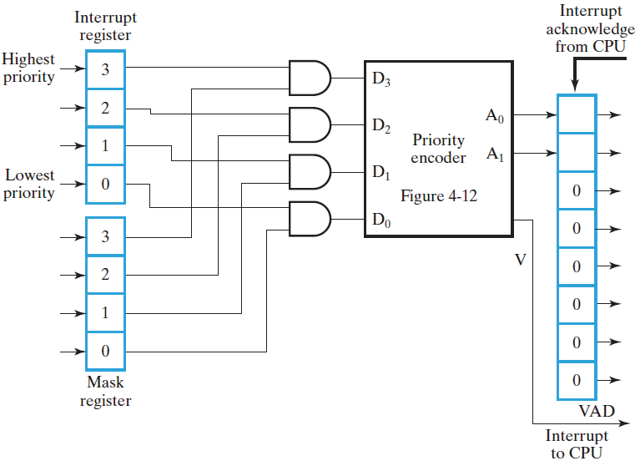
Parallel Priority Interrupt Hardware

Slide 52
Parallel Priority Interrupt Hardware
The parallel priority interrupt method employs two registers to manage interrupts.
The Interrupt Register is used to record which devices require service.
Devices are prioritized by the position of the bits in the register used to record a request for service.
Bit position 3 identifies the device having the highest priority and bit position 0 is set by the device having the lowest priority.
The Mask Register can be programmed to disable lower priority devices while a higher priority device is being serviced.
Service for a lower priority device may be interrupted to serve a higher priority device by employing the Mask Register.
The Priority Encoder produces two outputs, signal and the least significant two bits of the .
Signal is asserted when service is requested.
The least significant two bits of the designate the location of the service routine associated with the device making the request.

Slide 53
Direct Memory Access (DMA)
In the Direct Memory Access (DMA) the interface transfer the data into and out of the memory unit through the memory bus.
The transfer of data between a fast storage device such as magnetic disk and memory is often limited by the speed of the CPU.
Removing the CPU from the path and letting the peripheral device manage the memory buses directly would improve the speed of transfer. This transfer technique is called Direct Memory Access (DMA).
During the DMA transfer, the CPU is idle and has no control of the memory buses.
A DMA Controller takes over the buses to manage the transfer directly between the I/O device and memory.

Slide 54
Direct Memory Access (DMA)
The CPU may be placed in an idle state in a variety of ways. One common method extensively used in microprocessor is to disable the buses through special control signals such as:
Bus Request (BR)
Bus Grant (BG)
These two control signals in the CPU that facilitates the DMA transfer.
The Bus Request (BR) input is used by the DMA controller to request the CPU.
When this input is active, the CPU terminates the execution of the current instruction and places the address bus, data bus and read write lines into a high Impedance state. High Impedance state means that the output is disconnected.

Slide 55
Direct Memory Access (DMA)
ABUS
Address Bus
Bus Request
BR
DBUS
Data Bus
High Impedance (disable) when BG is enable
RD
Read
Bus Grant
BG
WR
Write
CPU bus Signals for DMA Transfer

Slide 56
Direct Memory Access (DMA)
The CPU activates the Bus Grant (BG) output to inform the external DMA that the Bus Request (BR) can now take control of the buses to conduct memory transfer without processor.
When the DMA terminates the transfer, it disables the Bus Request (BR) line.
The CPU disables the Bus Grant (BG), takes control of the buses and return to its normal operation.
The transfer can be made in several ways that are:
i. DMA Burst
ii. Cycle Stealing

Slide 57
Direct Memory Access (DMA)
DMA Burst :- In DMA Burst transfer, a block sequence consisting of a number of memory words is transferred in continuous burst while the DMA controller is master of the memory buses.
Cycle Stealing :- Cycle stealing allows the DMA controller to transfer one data word at a time, after which it must returns control of the buses to the CPU.

Slide 58
DMA Controller
The DMA controller needs the usual circuits of an interface to communicate with the CPU and I/O device. The DMA controller has three registers:
i. Address Register
ii. Word Count Register
iii. Control Register

Slide 59
DMA Controller
i. Address Register :- Address Register contains an address to specify the desired location in memory.
ii. Word Count Register :- WC holds the number of words to be transferred. The register is incre/decre by one after each word transfer and internally tested for zero.
iii. Control Register :- Control Register specifies the mode of transfer.

Slide 60
DMA Controller
The unit communicates with the CPU via the data bus and control lines. The registers in the DMA are selected by the CPU through the address bus by enabling the DS (DMA select) and RS (Register select) inputs. The RD (read) and WR (write) inputs are bidirectional.
When the BG (Bus Grant) input is 0, the CPU can communicate with the DMA registers through the data bus to read from or write to the DMA registers. When BG =1, the DMA can communicate directly with the memory by specifying an address in the address bus and activating the RD or WR control.

Slide 61
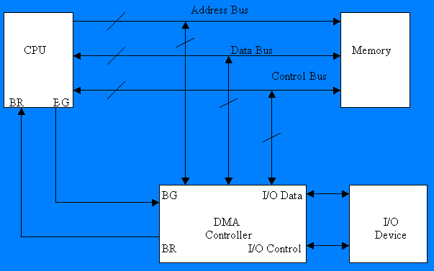
DMA

Slide 62
Address Bus
Data bus buffers
Address bus buffers
Data bus
INTERNAL
BUS
DMA Select
DS
Address Register
Register Select
RS
Word Count Register
Read
RD
Write
WR
Control Register
Bus Request
BR
Bus Grant
BG
DMA Request
Interrupt
Interrupt
to I/O devices
DMA Acknowledgment
Block Diagram of DMA Controller

Slide 63
DMA Transfer
The CPU communicates with the DMA through the address and data buses as with any interface unit. The DMA has its own address, which activates the DS and RS lines. The CPU initializes the DMA through the data bus. Once the DMA receives the start control command, it can transfer between the peripheral and the memory.
When BG = 0 the RD and WR are input lines allowing the CPU to communicate with the internal DMA registers. When BG=1, the RD and WR are output lines from the DMA controller to the random access memory to specify the read or write operation of data.

